Slide 1

CS598 - DL4H Project, Spring 23
Manu Vinod Shesha
Notes:
This is the presentation for research paper reproduction project, done for CS598 - Deep Learning for Healthcare, Spring 2023.

Slide 2

Original Paper
The original paper aims to automate the extraction of ICD-9 (Ninth Revision of International Classification of Diseases) codes from patient discharge summary, through application of DL techniques :
Document-to-Vector (D2V)
Convolution Neural Network (CNN).
Link: https://www.computer.org/csdl/journal/tb/2019/04/08320340/13rRUxASua9
Notes:
The original paper for this work, undertaken by researchers primarily from central south university china, aims to automate ICD-9 codes extraction from patient discharge summary using DL methods: Doc2Vec and CNN.

Slide 3
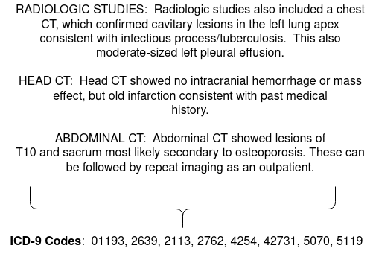
Motivation
ICD-9 Codes needed for Billing and Insurance Processing.
Extracting ICD-9 codes from discharge summary is a manual effort.
Why?
Discharge summaries are unstructured
Same diagnosis, different description
This is problematic.
Error prone
Time Taking
Needs specialized knowledge
We need automation to make this process faster, accurate, and scalable.
Notes:
The researchers are motivated by the fact that ICD-9 codes are essential for billing and insurance claims, and their extraction is largely a manual effort which is error-prone, time-consuming, and requiring specialized knowledge.
As we can infer, ICD-9 coding system is not simply a one-to-one mapping of a symptom/disease to a code. It combines a set of conditions to map to a specific code.

Slide 4
Authors’ Approach
Used CNN (Convolutional Neural Network) to capture local features to document
Used D2V (Document To Vector) to capture global features of document
Combined these two to generate document embeddings
These embeddings are applied in multi-label classification, each label representing an ICD-9 code.
Notes:
The novelty of this work is that the reserachers used CNN to capture local contextual features of a dcoument, and supplementing it with unsupervised Doc2Vec method to learn the global semantics of that document.

Slide 5
Claims Made by Authors
Claim 1
Higher Micro-average F1-score in multi-label ICD-9 classification task for the proposed model when compared to baseline models:
Flat-SVM and Hierarchical-SVM.
Model | Precision | Recall | F1-Score
flat-SVM | 0.635 | 0.158 | 0.253
hierarchical-SVM | 0.415 | 0.280 | 0.335
D2V+CNN | 0.486 | 0.351 | 0.408
Notes:
The authors claim that their proposed model outperforms the base ML-based models in terms of micro-averaged F1-score, by more than 13%.

Slide 6
Claims Made by Authors
Claim 2
Each of the components: CNN and D2V provide important contribution to the overall performance of the model (, with CNN being more important).
Model | Precision | Recall | F1-Score
Only CNN | 0.440 | 0.366 | 0.399
Only D2V | 0.375 | 0.261 | 0.308
D2V+CNN | 0.486 | 0.351 | 0.408
Notes:
They also claim that both CNN and D2V components are essential to the model, and its performance degrades if either of them is removed.

Slide 7
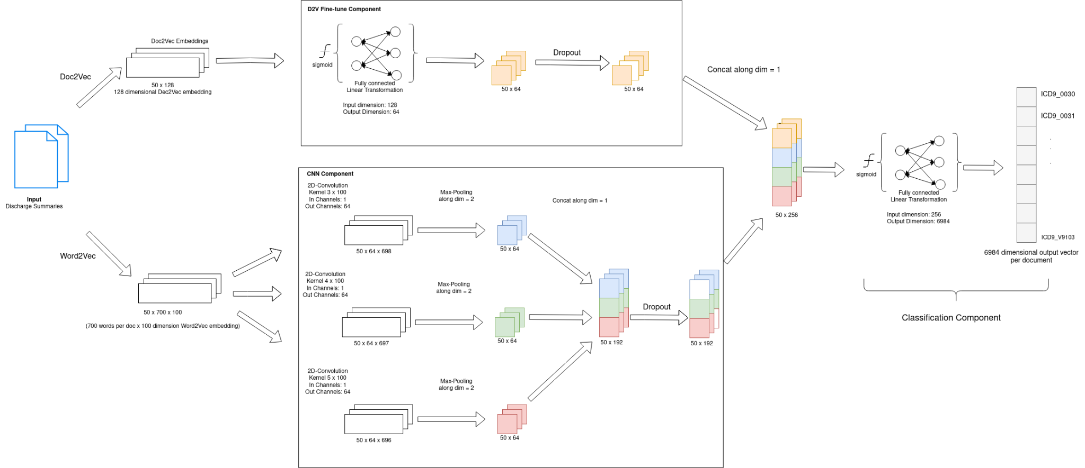
Architecture
Notes:
Lets look at the underlying architecture briefly.
At high level it consists of two components: Encoder, and Classifier.
The Encoder is responsible for generating the document embeddings. It uses two parallel paths D2V and CNN to generate individual embeddings and concatenates them for final output.
The Classifier is responsible to perform multi-label classification using these embeddings as input, where each label represents an ICD-9 code.
> Encoder to generate document embeddings:
The function of this component is to generate effective fixed-length embedding for a given discharge summary document.This component consists of two ”logical” sub-components:
– D2V: This sub-component first trains (as preprocessing step) Doc2Vec model to learn input document vectors of length 128, in an unsupervised way. It then fine-tunes these vectors in a supervised way using:
* Fully connected layer of 64 neurons, followed by a non-linear activation like ReLU (Rectified Linear Unit)
* Dropout layer which regularizes the output of fully-connected layer by stochastically dropping different dimensions of the output vector.
– CNN: This sub-component trains a Word2Vec model as pre-processing step to build word vectors (of size 100) for the whole vocabulary of the collective corpus of documents. For each document, all the vectors corresponding to the contained words, are ”stacked” as a matrix, to represent the given document. Batches of these document matrices are used as input to the CNN subcomponent. This sub-component actually comprises of 3 single-layer multi-channel CNN models. Three CNN models correspond to 3 kernel sizes of 3 (x 100), 4 (x 100), and 5 (x 100), with 64 output channels each. 2D CNN layer in each model is followed by a MaxPool layer to perform temporal pooling. The outputs of each of these CNN models are concatenated to generate the output vector per document of size 192 (3 models * 64 channels each). The output vectors from the two subcomponents (D2V and CNN) are concatenated to produce the final vector for each document in the batch. Ths final vector size is 256
(64 from DNN + 192 from CNN).
> Classifier to perform multi-label classification of ICD-9 codes. This component consists of a fully connected layer with sigmoid activation: This layer generates the final output of size 6984 (total number of ICD-9 codes). Each dimension (representing an ICD-9 code) is assigned a probability by sigmoid activation.

Slide 8
Data Used
MIMIC-III (Medical Information Mart for Intensive Care) datasets
DIAGNOSES_ICD.csv NOTEEVENTS.csv
ICD-9 Codes per hospital admission Discharge Summary Report per hospital admission
Total # codes | 6984
Avg. # codes per patient | 11
Max # of codes per patient | 39
Min # of codes per patient | 1
Total # discharge summary | 52691
Avg. # words per discharge summary | 1524
Max # of words per discharge summary | 7980
Min # of words per discharge summary | 9
Notes:
MIMIC-3 data was used, to perform training and validation. Here we are dealing with DIAGNOSES and NOTEEVENTS datasets.
The distribution of these 6984 ICD-9 codes across documents is heavily skewed, with the top 105 codes making up 50 percent of the total codes occurring across documents.

Slide 9
Methodology Used in Reproduction Project
Maintain the quality and quantity of data, to ensure that some important features are not dropped due to any data loss.
Do not alter the main parameters of the model (as proposed by authors) like word/document embedding lengths, kernel sizes, count of activation units, number of layers, etc.
Vary the hyperparameters: dropout rate, and classification threshold to achieve the desired performance level.

Slide 10
Results
Results for the main model
Sightly better micro-averaged F1-score than authors’ model
Comparable Precision and Recall
Model | Precision | Recall | F1-score
Original Model | 0.486 | 0.351 | 0.408
Reproduced Model | 0.502 | 0.351 | 0.413
Notes:
Lets go over the results of reproduction work.
The performance of main model could be replicated very closely. There was a slight improvement in F1-score, while still maintaining comparable precision and recall values.

Slide 11
Results
Results for the ablation experiments
Comparable results with original work for model without CNN and model without D2V
Model | Precision | Recall | F1-score
Only-D2V original | 0.375 | 0.261 | 0.308
Only-D2V reproduced | 0.350 | 0.261 | 0.299
Only-CNN original | 0.440 | 0.366 | 0.399
Only-CNN reproduced | 0.478 | 0.345 | 0.401
Notes:
Again with the ablation experiments, the reproduced models could achieve the similar results as obtained by original models.

Slide 12
Additional Experiments
DL model using CNN with Attention.
Intuition:
The originally proposed model uses Convolution with Max Pooling.
Ignores contribution of all group of tokens except the one with max value.
We may be able to do better by adding the weighted contribution of all groups of tokens (generated by convolution).
Notes:
In addition to the models proposed by the original paper, an alternative model was created which uses CNN with attention mechanism.
The intuition here is to replace Max Pooling layer in the CNN layer of the original model, with attention layer which allows weighted contribution of all groups of tokens, generated during convolution.

Slide 13
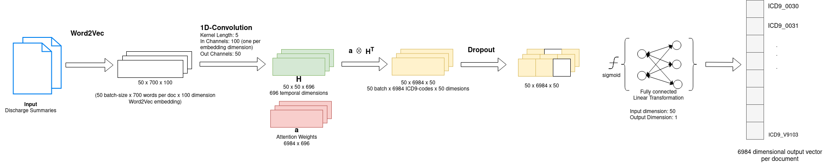
Architecture of Alternate model
Notes:
Differences with respect to original model in the paper:
No Doc2Vec component. Instead, we rely on contribution of the whole document by using attention weights.
We replace 2D convolution with 1D convolution over words. Here we treat Word2Vec embedding dimensions as in-channels. This way we generate 696 temporal dimensions in output, which represent the hidden state. Attention weights vector per output label is then applied to these 696 hidden states to get the final embeddings.
These generated embeddings are further utilized in classification component.

Slide 14
Results of Additional Model
Achieved better performance with the new model compared to originally proposed model.
Model | Precision | Recall | F1-score
Original (Reproduced) Model | 0.502 | 0.351 | 0.413
Additional Model | 0.520 | 0.372 | 0.434
Notes:
This alternative model achieved a better performance by 5% compared to the originally proposed model, even with very limited tuning.

Slide 15
Conclusions
Main model was reproduced successfully, supporting authors’ claim:
Proposed model performs better than base ML models for this task by 15-30% in-terms of micro-averaged F1-score.
Successfully performed ablations to support authors’ claim that both of the components: CNN and D2V are crucial to the architecture.
Additional model based on CNN + Attention built, with performance better that main model, by 5%.
Notes:
In conclusion, this results of this paper were successfully reproduced, both for the main model and for a couple of ablations.
In addition the experiments with alternate model provided valuable insights in the usefulness of attention mechanism in Deep learning.
On the whole, this was a great hands-on and learning experience.

Slide 16
Thank You

